Slide 1
Arrays
BACS2023 Object-oriented Programming
Chapter 3 – Part 1

Slide 2
Previously…
You have already learnt about arrays in c or c++ programming. This chapter will cover only the aspects of arrays in Java which are different from c or c++.
For a more complete review of arrays, refer to Appendix A5.

Slide 3
Learning Outcomes
At the end of this lesson, you should be able to :
Declare, create, initialize and use arrays in Java programs.
Simplify programming for arrays using foreach loops.
Apply the use of the arraycopy method to copy contents from one array to another.

Slide 4
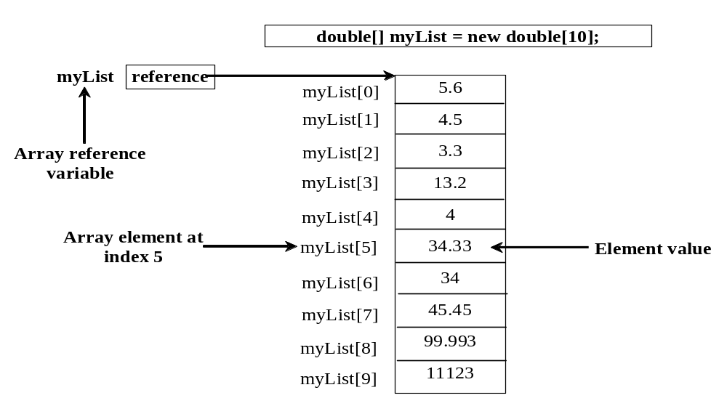
Recall what are arrays
Array is a data structure that represents a collection of the same types of data.
Notes:
Ask students:
Why / when do we need to arrays in our programs?
To store a large number of values during program execution.
-> Instead of declaring individual variables for 100 integers (i.e. 100 separate variables such as num1, num2, num3, .., num100), we declare one array variable e.g. numbers and use numbers[0], numbers[1], … numbers[99] to represent individual variables.

Slide 5
Declaring Array Variables
Purpose: to declare variables to reference arrays and specify the type of array the variable can reference.
Two ways:
  datatype[] arrayRefVar; //preferred style
  Example: double[] myList;
  datatype arrayRefVar[]; // not preferred
  Example: double myList[];
Notes:
The second style is allowed but not preferred. It is allowed to accommodate C programmers.

Slide 6
Creating Arrays
The declaration of an array variable does not allocate any space in memory for the array.
  ➔The array variable only creates a storage location for the reference to the array.
If the array variable does not refer to an array (i.e. the array has not been created), the value of the array variable is null.
Eg: double[] myList;
Array elements cannot be assigned to an array unless the array has already been created.
myList
null

Slide 7

Creating Arrays
To create an array, use the new operator.
Syntax:
  arrayRefVar = new datatype[arraySize];
Example:
double[] myList;
myList = new double[10];
myList
null
myList
0 1 2 3 4 5 6 7 8 9
Notes:
Review: What’s the difference between declaring and creating arrays?
E.g., in the statement
int[] arrayNum;
The array is declared (i.e. the array reference (arrayNum) is created), but there’s no array yet and arrayNum is null (i.e. pointing to nothing).
After the statement
arrayNum = new int[10];
an array of 10 int elements is created (each element initialized to the default value 0) and arrayNum is pointing to it.

Slide 8

Combining Array Declaration and Creation
A shorthand notation which combines declaring and creating arrays in a single statement.
Syntax
datatype[] arrayRefVar = new datatype[arraySize];
Example
double[] myList;
myList = new double[10];
double myList[] = new double[10];
myList
0 1 2 3 4 5 6 7 8 9

Slide 9

The Length of an Array
Once an array is created, its size is fixed and therefore, cannot be changed.
In Java, the array’s size may be obtained using
    arrayRefVar.length
For example,
double myList[] = new double[10];
    int length = myList.length;

Slide 10
Default Values
When an array is created, its elements are assigned the default value of
  0 for the numeric primitive data types
  '\u0000' for char typed array elements
  false for boolean typed array elements
Example
boolean[ ] myList = new boolean[10];
False | False | … | .. | … | … | … | … | … | False

Slide 11

Indexed Variables
In Java, array indexing is similar to C.
  Array indices are 0-based, i.e. it starts from 0 to arrayRefVar.length-1.
  Each element in the array is represented using the following syntax, known as an indexed variable: arrayRefVar[index]
Example :
double[ ] myList = new double[10];
System.out.println(mylist[8]);
mylist
0 | 0 | 0 | 0 | 0 | 0 | 0 | 0 | 0 | 0
0 1 2 3 4 5 6 7 8 9

Slide 12
Array Initializers
Declaring, creating and initializing in one step:
  double[] myList = {1.9, 2.9, 3.4, 3.5};
The new operator is not required.
The above shorthand notation is equivalent to the following statements:
  double[] myList = new double[4];
  myList[0] = 1.9;
  myList[1] = 2.9;
  myList[2] = 3.4;
  myList[3] = 3.5;
myList
1.9 | 2.9 | 3.4 | 3.5

Slide 13
CAUTION
Using the shorthand notation, you have to declare, create, and initialize the array all in one statement.
double[] myList = {1.9, 2.9, 3.4, 3.5};
Splitting it would cause a syntax error. For example, the following is wrong:
    double[] myList;
    myList = {1.9, 2.9, 3.4, 3.5};

Slide 14
Enhanced for Loop: foreach Loop
The foreach loop enables you to traverse the complete array sequentially without using an index variable.
Syntax:
for (elementType value: arrayRefVar) {
  // Process the value
  }
Example: To display all elements in the array myList,
  for (double value: myList)
  System.out.println(value);
You still have to use an index variable to
  traverse the array in a different order or
  change the elements in the array.
Notes:
for (elementType value: arrayRefVar) { // for each element in myList, do…
// Process the value
}

Slide 15
Example: Analyzing Array Elements
Objective: The program receives 6 numbers from the user, finds the largest number and counts the occurrence of the largest number entered.
Suppose you entered 3, 5, 2, 5, 5, and 5, the largest number is 5 and its occurrence count is 4.
TestArray

Slide 16
Copying Arrays
Often, we need to duplicate an array or part of an array.
In Java, the assignment operator may be used to copy primitive data type variables, but not arrays.
Example:
double[] myList = {1.9, 2.9, 3.4, 3.5};
double[] newList = myList; // does not copy

Slide 17
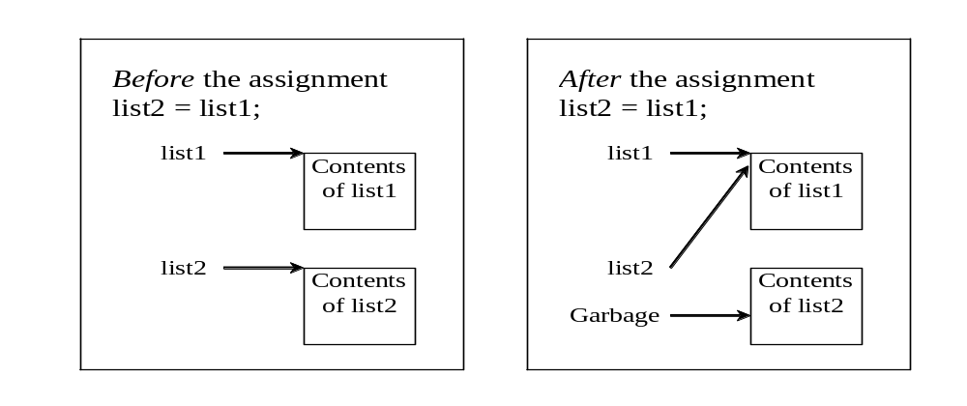
Copying Arrays
Assigning one array variable to another array variable copies one reference to another and makes both variables point to the same memory location :
  list2 = list1;
Notes:
After the following statement is executed
list2 = list1;
List2 also references the same array as list1. The array previously referenced by list2 is no longer referenced.
Hence, it becomes garbage and will be automatically collected by the JVM.

Slide 18
Copying Arrays
Ways to copy arrays:
(a) Use a loop:
int[] sourceArray = {2, 3, 1, 5, 10};
int[] targetArray = new int[sourceArray.length];
for (int i = 0; i < sourceArrays.length; i++)
targetArray[i] = sourceArray[i];
sourceArray
2 | 3 | 1 | 5 | 10
targetArray

Slide 19
Copying Arrays
(b) Use the arraycopy method from the java.lang.System class
Syntax
arraycopy(sourceArray, src_position,
targetArray, target_position, length);
Example
System.arraycopy(oldArray, 0, newArray, 0,
oldArray.length);
The arraycopy method does not allocate memory space for the target array, i.e. the target array must have already been created.
After copying, the target array and source array have the same content but independent memory locations.

Slide 20
Exercise
Given the array declaration and creation statements
int[] arrayA = {1, 2, 3, 4, 5, 6, 7, 8, 9};
int[] arrayB = new int[5];
int[] arrayC = new int[3];
int[] arrayD = new int[10];
write statements using the arraycopy method to
Copy the first 5 elements of arrayA into arrayB.
Copy the last 3 elements of arrayA into arrayC.
Copy the middle 3 elements of arrayA into arrayD.
System.arraycopy(arrayA, 0, arrayB, 0, 5);
System.arraycopy(arrayA, 6, arrayC, 0, 3);
System.arraycopy(arrayA, 3, arrayD, 0, 3);

Slide 21
Arrays
BACS2023 Object-oriented Programming
Chapter 3 – Part 2

Slide 22
Learning Outcomes
At the end of this lesson, you should be able to
Develop and invoke methods with array arguments.
Explain the difference between passing primitive-typed arguments and reference-typed arguments.
Develop and invoke methods with an array return value.

Slide 23
Passing Arrays to Methods
Invoke the method
int[] list = {3, 1, 2, 6, 4, 2};
printArray(list);
public static void printArray(int[] array) {
for (int i = 0; i < array.length; i++) {
System.out.print(array[i] + " ");
}
}

Slide 24
Anonymous Array
public static void printArray(int[] array) {
for (int i = 0; i < array.length; i++) {
System.out.print(array[i] + " ");
}
}
  The statement
  printArray( new int[]{3, 1, 2, 6, 4, 2});
  creates an array using the following syntax:
    new dataType[ ] { literal_0, literal_1, ..., literal_k };
  There is no explicit reference variable for the array. Such array is called an anonymous array.
3 | 1 | 2 | 6 | 4 | 2

Slide 25
Pass By Value
Java uses pass by value to pass arguments to a method.
  There are important differences between passing the value of variables of primitive data types and passing arrays.
For a parameter of a primitive type value, the actual value is passed.
  Changing the value of the formal parameter inside the method does not affect the value of the variable passed as argument in the method call.
For a parameter of an array type, the value of the parameter contains a reference to an array; this reference is passed to the method.
  Any changes to the array that occur inside the method body will affect the original array that was passed as the argument.

Slide 26
Pass By Value
public class Test {
public static void main(String[] args) {
int x = 1;
int[] y = new int[10];
m(x, y); // Invoke m with arguments x and y
System.out.println("x is " + x);
System.out.println("y[0] is " + y[0]);
}
public static void m(int number, int[] numbers) {
number = 1001; // Assign a new value to number
numbers[0] = 5555; // Assign a new value to numbers[0]
}
}
Notes:
x is 1
y[0] is 5555

Slide 27
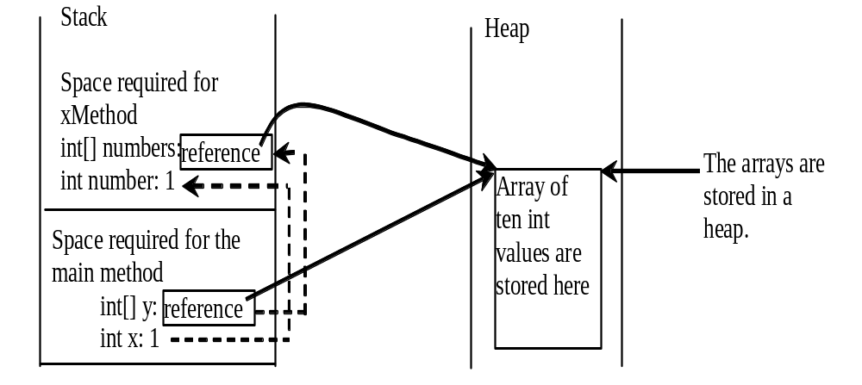
Heap
The JVM stores the array in an area of memory, called heap, which is used for dynamic memory allocation where blocks of memory are allocated and freed in an arbitrary order.
Notes:
The primitive type value in x is passed to number, and the reference value in y is passed to numbers

Slide 28
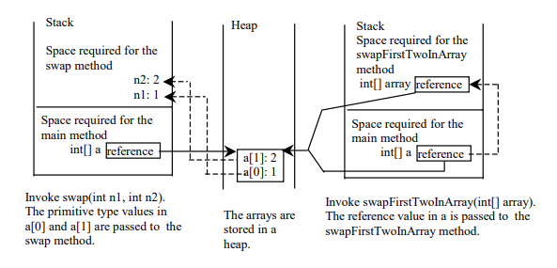
public static void main(String[] args){
int[] a = {1, 2};
swap(a[0], a[1]);
swapFirstTwoInArray(a);
}
public static void swapFirstTwoInArray(int[] array){
int temp = array[0];
array[0] = array[1];
array[1] = temp;
}
public static void swap(int n1, int n2) {
int temp = n1;
n1 = n2;
n2 = temp;
}

Slide 29
Returning an Array from a Method
int[] list1 = new int[]{1, 2, 3, 4, 5, 6};
int[] list2 = reverse(list1);
public static int[] reverse(int[] list) {
int[] result = new int[list.length];
for (int i = 0, j = result.length - 1;
i < list.length; i++, j--) {
result[j] = list[i];
}
return result;
}
ArrayMethods.java
1 | 2 | 3 | 4 | 5 | 6
list
result

Slide 30
Variable-Length Argument Lists (Optional)
To pass a variable number of arguments of the same type to a method, the parameter in the method is declared as:
typeName… parameterName
Only one variable-length parameter may be specified in a method, and this parameter must be the last parameter.
Java treats a variable-length parameter as an array.
public class VarargsDemo {
public static void main(String args[]) {
printMax(34, 3, 3, 2, 55.5);
printMax(new double[]{1, 2, 3});
printMax();
}
public static void printMax (double... numbers) {
  if (numbers.length == 0) {
  System.out.println("No argument passed");
  return;
  }
  double result = numbers[0];
  for (int i = 1; i < numbers.length; i++)
  if (numbers[i] > result)
  result = numbers[i];
  System.out.println(“Max value is " + result);
  }
}
VarargsDemo.java

Slide 31
The Arrays Class (Optional)
The java.util.Arrays class contains various static methods for manipulating arrays:
These methods are overloaded for all primitive types.
TestArraysClass.java
Method | Description
binarySearch | Searches an array for a target value - returns the location of the target if found; if target not found, it returns –(insertion_point + 1). The array must be pre-sorted in increasing order.
sort | Sorts an array into ascending order of its elements.
equals | Checks whether two arrays have the same contents.
fill | Fills the whole or part of the array with the specified value.

Slide 32
Two-dimensional Arrays (Optional)
// Declare a two-dimensional array reference variable
dataType[][] refVar;
// Create array and assign its reference to variable
refVar = new dataType[10][10];
// Combine declaration and creation in one statement
dataType[][] refVar = new dataType[10][10];

Slide 33
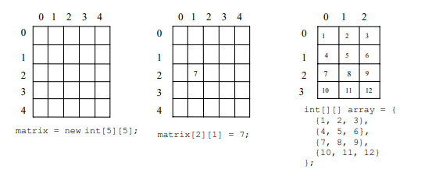
Creating & Initializing 2D Arrays (Optional)
Create an array called matrix
int[][] matrix = new int[10][10];
Initialize the array with random numbers ranging from 0 to 999.
for (int i = 0; i < matrix.length; i++)
for (int j = 0; j < matrix[i].length; j++)
matrix[i][j]=(int)(Math.random()*1000);

Slide 34
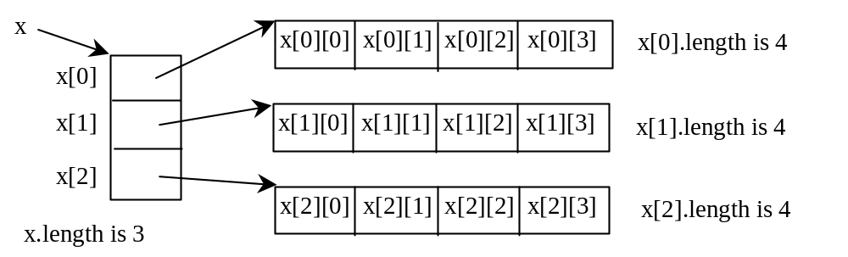
Lengths of Two-dimensional Arrays (Optional)
int[][] x = new int[3][4];

Slide 35
Lengths of Two-dimensional Arrays (Optional)
int[][] array = {
{1, 2, 3},
{4, 5, 6},
{7, 8, 9},
{10, 11, 12}
};
array.length
array[0].length
array[1].length
array[2].length
array[3].length
array[4].length ArrayIndexOutOfBoundsException

Slide 36
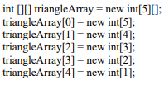
Ragged Arrays (Optional)
Each row in a two-dimensional array is itself an array. So, the rows can have different lengths. Such an array is known as a ragged array. For example,
int[][] matrix = {
{1, 2, 3, 4, 5},
{2, 3, 4, 5},
{3, 4, 5},
{4, 5},
{5}
};
matrix.length is 5
matrix[0].length is 5
matrix[1].length is 4
matrix[2].length is 3
matrix[3].length is 2
matrix[4].length is 1
1 2 3 4 5
2
3
4
5
3
4
5
4
5
5

Slide 37
To Do
Review the slides and source code for this chapter.
Read up the relevant portions of the recommended text.
Complete the remaining practical questions for this chapter.
  We shall selectively discuss them during class.

